Slide 1
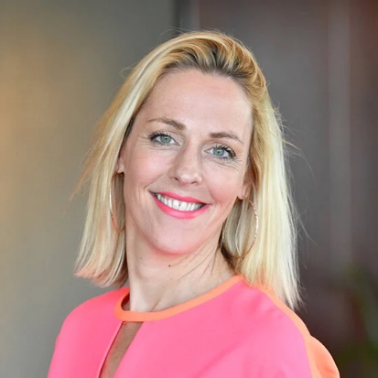
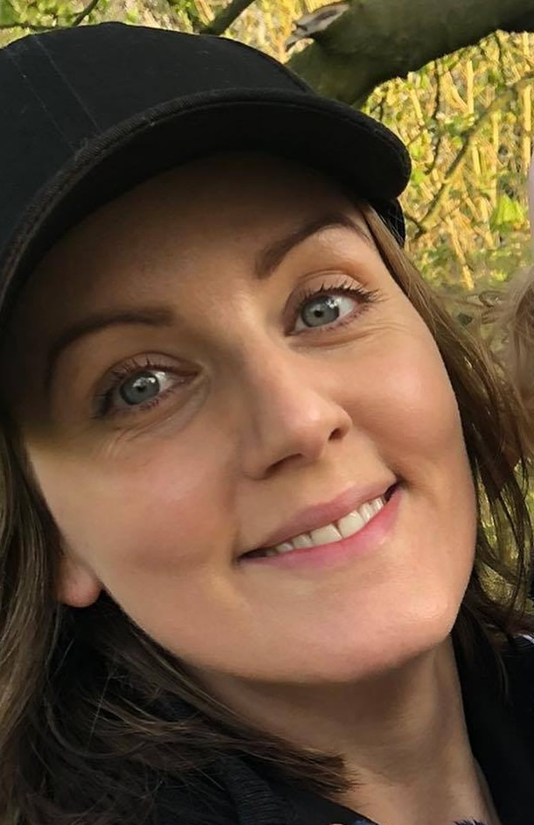
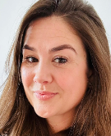
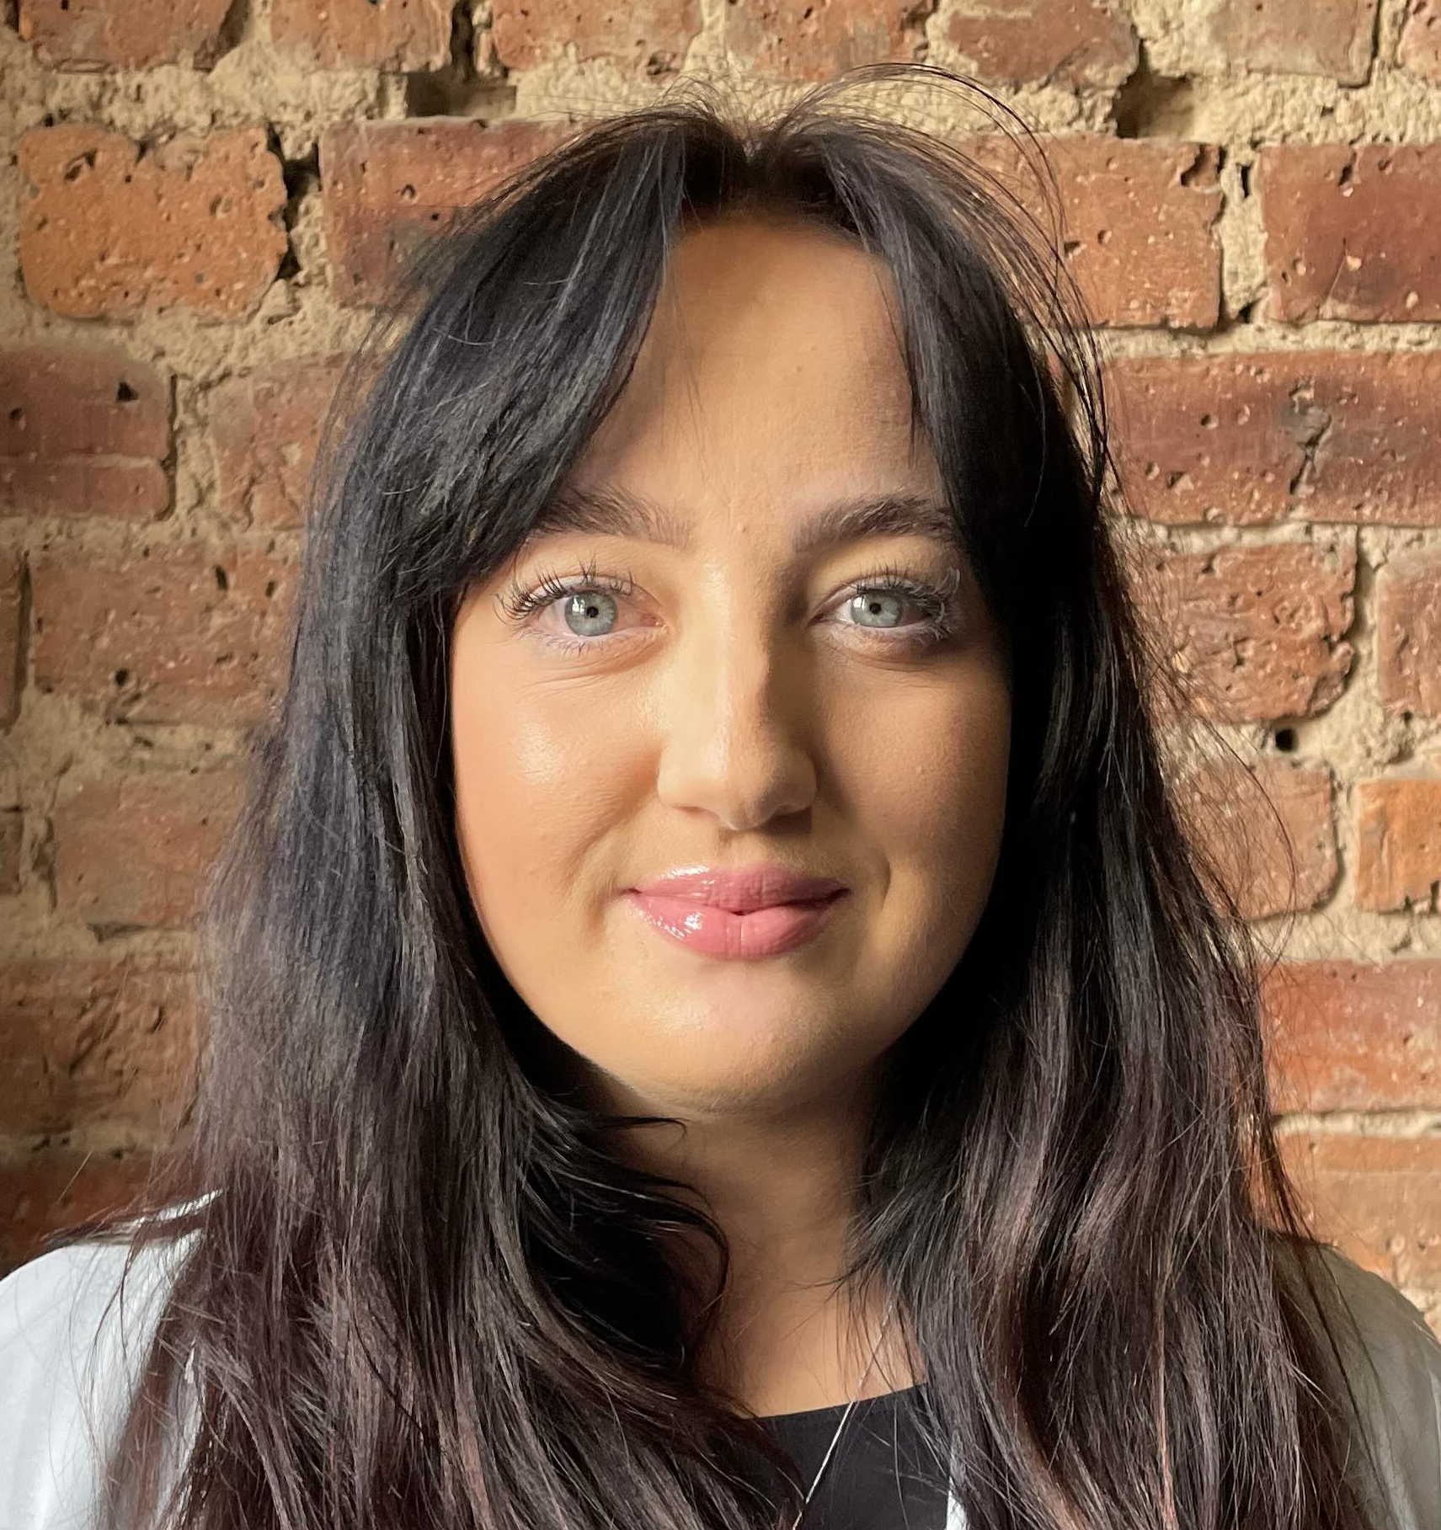
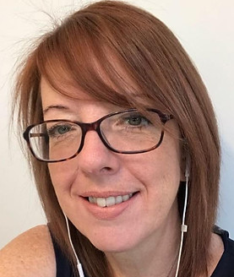
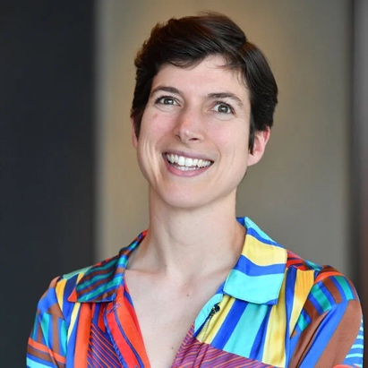
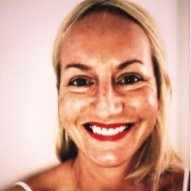

NAPATS 2026 Webinar Hosts
Welcome! Below are photos of all of us on this meeting.
PGGB: Netflix: Access All Areas: Lead Trainer: BSL Interpreter:
Becky Maynard
Head of Talent Development
Catherine Francis-Driscoll
Production Access
Lucy Andrews
Access Coordinator
Bex Scott
Freelance Financial Controller
Caroline Corrigan
NRCPD Registered Sign Language Interpreter
Susanna Hargreaves
Training Executive
Lizzie Brizzell
Production Finance

Slide 2

2. Webinar Housekeeping
Please turn your camera and mic off for the presentation
Please pin Caroline Corrigan (BSL Interpreter) on your screens
The live caption link is in the chat or press the CC button for captions direct to the zoom window
Please type questions in the chat at any point during the webinar and we will address them in the Q&A
You can use the "hand up" function during the Q&A if you would prefer

Slide 3

3. Webinar Running Order
1.00-1.30pm
Welcome, housekeeping and intros
Working in production accounts
The application process
The training course
The placements
We will talk about access throughout
1.30-1.35pm
5 minute break around this time
1.35-2.00pm
Q&A

Slide 4
4. Hosts Introductions
A little bit more information about us!
PGGB: Netflix: Access All Areas: Lead Trainer: BSL Interpreter:
Becky Maynard
Head of Talent Development
Catherine Francis-Driscoll
Production Access
Lucy Andrews
Access Coordinator
Bex Scott
Freelance Financial Controller
Caroline Corrigan
NRCPD Registered Sign Language Interpreter
Susanna Hargreaves
Training Executive
Lizzie Brizzell
Production Finance

Slide 5

5. The role of Assistant Production Accountant
What is the role like in reality?
Why is Bex passionate about leading this course?
Why is it such a unique opportunity?

Slide 6
6. Key Dates
Tuesday 10am, 4th November 2025 | Application deadline
Wednesday 12th November 2025 | Email sent inviting candidates to interviews
Wednesday 19th November 2025 | Deadline to respond to invitation to interview
Monday - Thursday 1st - 4th December 2025 | Interview Tests
Tuesday - Friday 2nd - 5th December 2025 | Interviews
Monday 8th December 2025 | Places on course offered by
Monday - Monday 8th -15th December 2025 | References contacted
Tuesday 16th December 2025 | Places on course confirmed by
Wednesday 25th February 2026 | Course starts

Slide 7
7. The Training Course
Location – Shepperton South Studios
Course dates – 25th February to 27th March
Daily timings – 9.30am to 5.00pm
Sessions – 4 sessions per day, each session lasting approximately 1.5 hours
Breaks – 15 minutes in the morning and afternoon, and 1 hour at lunch

Slide 8
8. The Netflix Placements
Location – Shepperton Studios or Longcross Studios
Dates – March 2026 to February 2027
Type of production – Film or TV series
Mentor – industry professional at Netflix

Slide 9
9. Break
We'll take a 5 minute break now
Please feel free to type your questions in the chat
We will try to make sure they are all answered by the end of the session

Slide 10

10. Q&A
No question is a silly question!
Type a question in the chat
Use the "hand up" function to ask out loud
Type something like "BSL question" in the chat if you'd like Caroline to interpret for you

Slide 11
Thank you for coming and good luck with your application!
Please take a look on our website where you'll find our Application Pack and FAQs-
https://productionguild.com/training-courses/upcoming-courses/napats-2026/
You are welcome to contact us after this webinar
For access related questions- access@productionguild.com
For application or other general questions- applications@productionguild.com

